Slide 1
Capstone project
Marketing & Retail Analytics
-Prashanth R
DS C38

Slide 2
PROBLEM STATEMENT
OList is an e-commerce company that has faced some losses recently and they want to manage their inventory very well so as to reduce any unnecessary costs that they might be bearing.
Need to identify top products that contribute to the revenue and also use market basket analysis to analyse the purchase behaviour of individual customers to estimate with relative certainty, what items are more likely to be purchased individually or in combination with some other products.

Slide 3
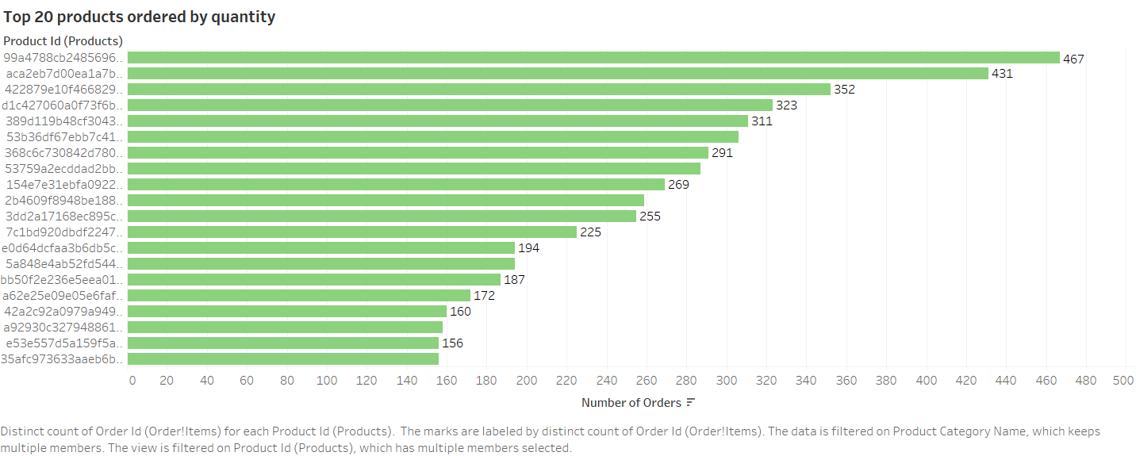
Top 20 products ordered by quantity

Slide 4
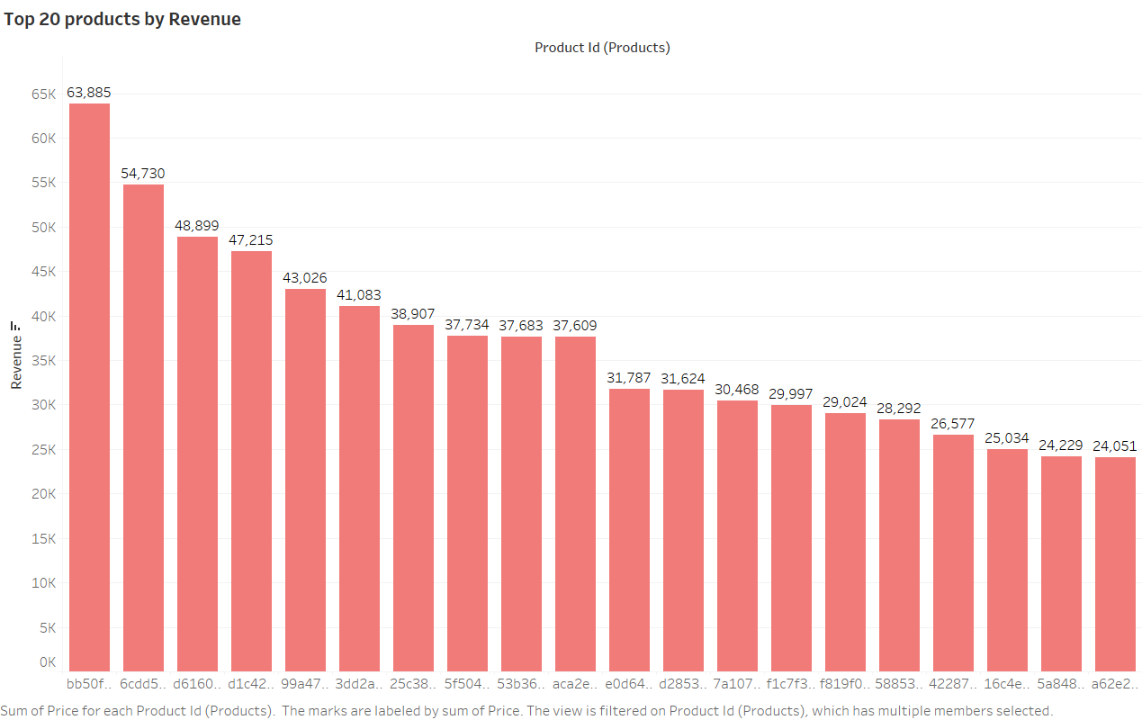
TOP 20 PRODUCTS BY REVENUE

Slide 5
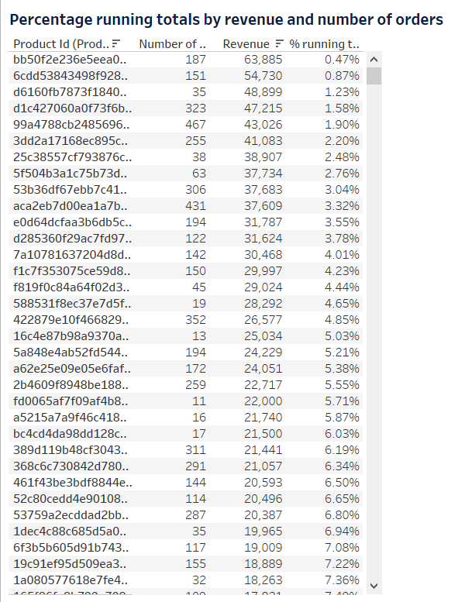
Revenue pareto
This Revenue Pareto shows the percentage running total, revenue generated and number of orders.
This can be used to identify the contribution of the products towards the total revenue.

Slide 6
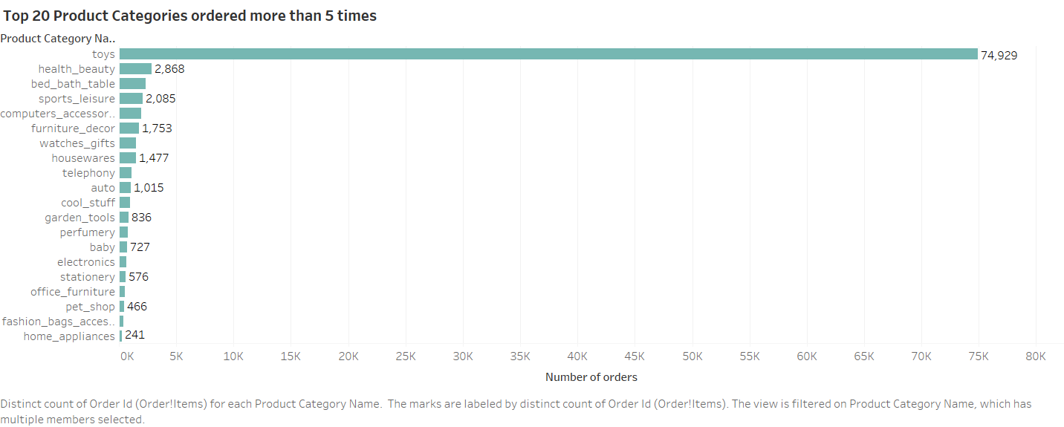
CATEGORIES ORDERED MORE THAN 5 TIMES

Slide 7
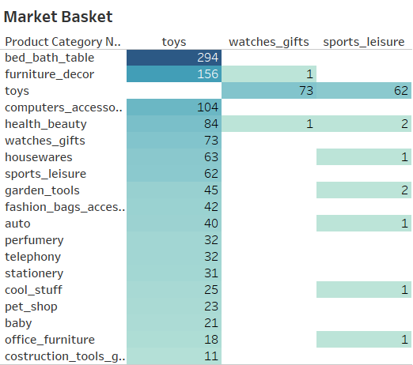
MARKET BASKET ANALYSIS
Market Basket analysis was used to identify the association of frequently ordered product combinations.
From the visual, we can observe that toys are often ordered together with bed_bath_table which constitutes the highest.
Other combinations with toys include furniture_decor, sports_leisure, housewares, health_beauty, etc.

Slide 8
insights
The product category ‘toys’ is the most ordered category with 74929 orders which constitutes more than 75% of the ordered products.
The highest revenue earning product accounts to 63,885 which is from toys category.
It is observed from the top 20 products analysis, that despite of the high cost of the products, they are ordered frequently by the customers.
Apart from toys category, other category ordered by customers more than 5 times include health_beauty, bed_bath_table, sports_leisure, computer_accessories, furniture_decor, etc.
The above mentioned categories are often ordered in combination with toys and with each other and are predominant in the customers’ baskets.

Slide 9
recommendations
The target customers can be parents of newly born babies and/or children below 5 years of age and are likely to purchase toys.
More offers and discounts can be rolled out in order to retain the customers who frequently order on the platform.
Inventory can be stocked more of products which are ordered in combination with toys.
The products ordered in combination with another can be sold at a rate cheaper than the total in order to attract new customers.
Maintain more products which helped to earn more revenue so that there is high chance of making profit.

Slide 10
appendix
Data source: The dataset used was the Retail dataset provided.
Data assumption: The products having order_status as ‘delivered’ only were considered for analysis.
Data cleaning: The columns ‘order_approved_at’ and ‘order_delivered_timestamp’ and ‘order_purchase_timestamp’ and ‘order_estimated_delivery_date’ are assumed to be respectively equivalent.
Data visualization: Visualization of the cleaned data was done on Tableau Desktop to obtain proper insights.

Slide 11
Thank you.

